Slide 1
Gastrointestinal disorders in children

Slide 2
Introduction
Review of GIT anatomy
Components of the gastrointestinal (GI) system:
Alimentary canal
Accessory organs.
Mouth
- Entrance to the GIT
- Starts the process of digestion.
- Saliva -produced by submandibular, parotid and sublingual glands in response to smell, taste & thought of food
- Tongue contains taste buds that distinguish sweet, sour, bitter and salt taste.
The tongue is essential for swallowing.

Slide 3
Esophagus
Upper esophageal sphincter (UES);
- prevents esophageal reflux into pharynx
- prevents esophageal distension during breathing
lower esophageal sphincter (LES)- cardiac sphincter
- prevents stomach contents reflux into esophagus.
Swallowing is both voluntary and involuntary
Stomach
Divided into fundus, body and pylorus
Churns bolus into chyme
Mucous bicarbonate layer buffers the acidic chyme from eroding the stomach

Slide 4
Lower Gastrointestinal System
Includes the duodenum, liver, gallbladder, pancreas, ileum, caecum, appendix, ascending colon, transverse colon, sigmoid colon and rectum & anus.
The pancreas produce insulin, glucagon, amylase, trypsin, lipase and bicarbonate to aid digestion
The liver is the is the second largest organ in the body, divided into two lobes by falciform ligament
The blood supply is from hepatic artery & hepatic portal vein
The liver has many functions:- phagocytosis, bile production, storage of glycogen & vitamins, deamination of protein, heat production and detoxification

Slide 5
The gall bladder store bile, necessary in fat digestion
Jejunum & ileum are for absorption of the nutrients and vitamins. Absorption of Vitamin B₁₂ occurs only in the terminal ileum
The function of the large intestines include:
- water absorption mostly in the cecum & ascending colon.
- Synthesis of vitamins B & K
- mucous secretion & peristalsis of waste
The rectum is the last 7-8 inches of the intestines.
stool is stored in the rectum until distended to initiate defecation reflex
The anal canal refers to the last 1-2 inches the of intestines, expels undigested and indigestible products of digestion

Slide 6
Abdominal Examination
Inspection
Observe the abdomen for contour and any markings while the child is standing and when lying down.
Inspect the umbilicus for cleanliness and the presence of scar tissue.
Observe respiratory movements
Auscultation
Because percussion and palpation will stimulate the small bowel and increase bowel sounds, auscultation should precede these two techniques.
Bowel sounds are heard as tinkling, irregular sounds that indicate that fluid is moving from one section of the bowel to the next.
Percussion
On the right side, percuss for the liver. Confirm on palpation.
Liver dullness can frequently be outlined to determine size of the liver.
Percuss over the left upper quadrant (LUQ).

Slide 7
Percussion over a gas-filled bowel or stomach results in a high-pitched, hollow sound.
Percuss the lower abdomen, particularly above the symphysis pubis.
Above the symphysis pubis, a filled bladder can produce a duller sound, as does a pregnant uterus.
The liver is frequently felt about 1 cm- 2cm below the right costal margin. This is a common finding in the neonate and through the early school-age years.
Palpation
Divide the abdomen into imaginary quadrants, palpating each with the fingertips.
In the RUQ, palpate for the liver edge.
Although the liver is easily palpable in most children, you may have to press quite firmly.

Slide 8
In the LUQ, palpate for the spleen. Less resistance is encountered as you feel up under the left costal margin.
In the upper quadrants, deeply palpate for the kidneys to make sure there is no enlargement of the kidney. Normally, the kidney is not palpable.
In the iliac fossa or the left lower quadrant, palpate for the descending bowel. This can be felt, particularly if it's filled with firm stool. It may be slightly tender, but it should not cause severe pain on gentle palpation.
Palpate on the right RLQ where the appendix is located. The only sensation is that of gas-filled bowel. Tenderness in this area could be related to an inflamed appendix.

Slide 9
If the child has pain in any area when asked to show where the pain is, avoid the area demonstrated, and leave it until last. Note whether the pain is with pressure or rebound.
Palpate around the umbilicus for any masses that may indicate a hernia. As you press over the protruding hernia you can feel the sensation of gurgling under your fingers as the bowel returns to the abdomen.
Most of these hernias heal naturally by age 6 years. A hernia above the umbilicus can be revealed by asking the child to lift his head from the table. (Widening of the muscles above the umbilicus is called diastasis recti)

Slide 10
Examination of the rectum and anus
Inspection
In infants or toddler, place the child on a flat surface so that the weight is evenly distributed on the front of the pelvis. As the infant moves about on the abdomen, observe the entire back, the lower back, the upper thigh, and the tightening of the buttocks and symmetry
Check particularly the lower part of the back for hairiness or a mass.
Part the butt chicks and inspect the cleft between for pilonidal dimple or sinus.
Note the outer appearance of the anus and the perineum, the underside of the scrotum in the male, and the labia majora in the female.
Inspect the anus for blood, fissures, or splitting in the external tissue, redness, swelling, or pads of extra flesh or worms

Slide 11
Palpation
This part of the examination is not always needed.
Part the buttocks with the left hand and introducing a well-lubricated finger into the anus.
Gently apply pressure on the anal sphincter with the pulp of the finger to allow the muscles to relax and the fingertip to slide into the rectum.
Gently palpate the inner ring, feeling for areas of thickening and tenderness and simultaneously judging the sphincter tone.
Palpate the walls of the rectum, mucosal walls should be smooth, and deep palpation should elicit mild tenderness and no acute pain.
In the male, gently turn your finger through 180 degrees and feel the posterior surface of the prostate. Note size, consistency, tenderness, and contour.
In the female, perform a bimanual examination and palpate the cervix.

Slide 12
Peadiatric differences in the GIT system
Infant s have minimal saliva
Swallowing is not under voluntary control until 6wks
Infants & children have less stomach capacity
Age Stomach capacity (mls)
newborn 10-20
1wk 30-90
2-3wks 75-100
1mnth 90- 150
3mnths 150- 200
1yr 210- 360
2yrs 500
10yrs 750- 900
16yrs 1500
adult 2000-3000

Slide 13
Gastric emptying time is 2-3 hrs and peristalsis is faster; fever increases propulsion
Metabolic rate is faster, resulting in greater production of metabolic wastes
infancy causing regurgitation and vomiting
HCL acid concentration is low until school age
Immature liver – insufficient detoxifying less vitamin and mineral breakdown; varies with age
Small intestine is proportionately greater and secretes more fluids and electrolytes than in adulthood. Consequently more prone to dehydration.
Infants are deficient of several digestive enzymes; amylase produced at 4-6 months, lactase low in preterm and after early childhood
Intestine more permeable to proteins in infancy therefore prone to food allergies
The large intestine is relatively short with, with less epithelial lining to absorb water from fecal mass- stools have soft consistency and peristalsis is rapid.

Slide 14
Classification of GIT conditions
Congenital defects e.g. cleft lip & palate,tracheoesophageal atresia & fistula, imperforate anus, abdominal wall defects
Motility disorders e.g. GER, constipation, encopresis, irritable bowel syndrome
Inflammatory & infectious conditions e.g. NEC, IBD, GE, appendicitis.
Obstructive disease e.g. pyloric stenosis, Intussusception and Hirchsprung disease
Malabsorption condition e.g. lactose intolerance and celiac disease
Accessory organs disorders e.g. hepatitis, biliary atresia & cirrhosis, pancreatitis

Slide 15
Tracheoesophageal Atresia and Fistula
Esophageal atresia (EA) is failure of the esophagus to form a continuous passage from the pharynx to the stomach during embryonic development.
EA can occur with tracheoesophageal fistula (TEF), which is an abnormal connection between the trachea and esophagus.
TEA or TEF Occurs at 4-5 wks gestation due to failure of proper separation of the embryonic channel into the esophagus and trachea.
Etiology unknown, possible influences include:
Inheritable genetic factor
Chromosomal (structural) abnormalities
Teratogens such as adriamycin and diethylstilbestrol (DES).

Slide 16
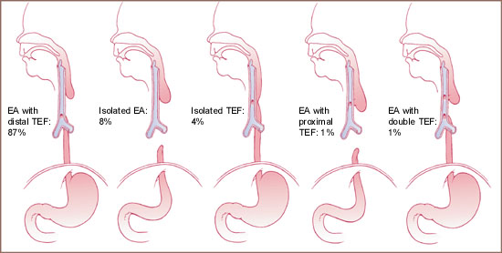
Classification of TEF

Slide 17
The esophagus in EA is inherently abnormal.
Esophageal dysmotility and consequent delayed esophageal emptying increase the duration of exposure of the esophageal mucosa to gastric acid in infants,with GE reflux.
Many infants also have an abnormally soft trachea (tracheomalacia). When the tracheomalacia is severe, the trachea tends to collapse and may cause obstruction on expiration
Dx:
Hx of maternal polyhydramnios
Infant born slightly prematurely
Symptoms: Cyanotic episodes and respiratory distress shortly after birth; Excessive oral mucous (blowing bubbles); “Double bubble”, drooling of saliva.
Inability to pass a catheter (10 gauge) to the stomach, becomes arrested 9-10 cm from the gums
Litmus paper confirms fluid aspirated is acidic
Abd x-ray shows stomach distended with air
Radiopaque NG tube will x-ray as curled in esophagus

Slide 18
Presence of other associated anomalies VARTEL Syndrome ( vertebral, anorectal, respiratory ,TEF, limbs), down syndrome.
Signs & Symptoms:
3 C’s - coughing, choking, and cyanosis; excessive oral mucous, bubbles, drooling
Explosive ejection of the milk on feeding associated with cyanosis, choking and respiratory distress.
Abdominal distention.
Intermittent, unexplained cyanosis and laryngospasm.
Management
Minimum handling to prevent high O2 consumption, exposure of the infant to cold stress which may cause dramatic cardiovascular responses.
O2 therapy to prevent respiratory distress 2o prematurity, aspiration pneumonia or diaphragmatic splinting caused by excessive escape of air through the distal fistula into the stomach.
Nurse in the supine position prop infant at 30-degree angle; minimizes regurgitation of gastric contents up the distal TEF, decrease the work of breathing and improve oxygenation.

Slide 19
NPO; I.V. fluids.
RX co morbidities, such as pneumonitis and HF.
Suction the upper esophagus intermittently to remove accumulating saliva.
Administer antibiotics as ordered to prevent or treat associated pneumonitis.
Premature care; temperature control, O₂, early fluid and dextrose solution resuscitation to limit the problems of apnoea, respiratory distress and hypoglycaemia.
Care of parents; give an honest appraisal of the situation. In absence of associated severe congenital abnormalities, prognosis for survival is excellent.
Surgical management: Thoracotomy with division and ligation of TEF and end to end anastomosis of esophagus. This can be a single procedure or done in stages.

Slide 20
Post-op care;
Maintain patent airway
Prevent trauma to the anastomosis, elevate gastrostomy tube
Provide adequate nutrition
Provide comfort measures
Observe for complications
Stimulate parent-infant attachment
support & teach parents, routine pre and post op care plus normal neonatal care

Slide 21
Motility disorders
Vomiting
Presenting complaint in a variety of disorders
Vomiting is a coordinated motor response of the GI tract and abdominal and thoracic muscles that results in the forceful expulsion of stomach contents. Three basic phases of vomiting can be differentiated.
Nausea, which is the sensation of impending vomiting often associated with autonomic symptoms of pallor, diaphoresis, salivation, and anorexia.
Retching, which is the spasmodic respiratory movements against a closed epiglottis.
Emesis, which is the retrograde expulsion of gastrointestinal contents through the mouth.

Slide 22
Classification of vomiting- (duration)
Acute vomiting
Short-term episodes of abrupt onset
oral rehydration usually is effective. Occasionally, however, intravenous hydration is required.
Pharmacologic agents are avoided in children because they may mask the outward signs of serious disease.
Recurrent vomiting
Classified into;
Chronic vomiting- associated with relatively mild vomiting episodes that occur frequently

Slide 23
Cyclic vomiting- recurrent intense episodes of rapid vomiting separated by asymptomatic periods.
Common in girls aged 6 to 7
Several weeks between episodes
Strong association with family history of migraines
Must evaluate for organic disease
Treatment difficult – beta-blockers
Dx and Rx;
Evaluate and correct dehydration and other life threatening conditions first
Describe the nature, associated factors and history of vomitus and r/o underlying pathology

Slide 24
Nature of Vomitus
COLOR/TASTE/ CONSISTENCY | POSSIBLE SOURCE
Yellowish or greenish | May contain bile Medication
Bright red (arterial) | Hemorrhage, peptic ulcer
Dark red (venous) | Hemorrhage, esophageal or gastric varices
Coffee ground | Digested blood from slowly bleeding gastric or duodenal ulcer

Slide 25
Nature of Vomitus
COLOR/TASTE/ CONSISTENCY | POSSIBLE SOURCE
Undigested food | Undigested food
Bitter taste | Bile
Sour or acid | Gastric contents
Fecal components | Intestinal obstruction

Slide 26
Diarrhea
Rapid movement of fecal matter through the intestine, resulting in an excessive loss of water and electrolytes resulting in frequent loose (>4-5 in 24 hrs), unformed, or watery stools.
In addition, it causes dehydration, electrical imbalance, metabolic acidosis and monosaccharide intolerance and protein hypersensitivity
It is a symptom of many conditions and may be caused by many diseases.
Major cause of infant mortality in developing countries
Most commonly viral, -usually rotaviruses or adenoviruses
Bacterial causes,- C. difficile, salmonella, Giardia, and Campylobacter
Noninfectious causes; Malabsorption, IBD, Immune deficiency, hyperthermia, stress, Irritation of GIT, Inappropriate use of laxatives and purgatives, mechanical disorders, congenital anomalies
Always serious in infancy due to small ECF reserve, therefore can dehydrate quickly

Slide 27
Mechanisms of Diarrhea
Secretory—decreased absorption, increased secretion
Osmotic—maldigestion, transport defects, ingestion of unabsorbable solute
Increased motility—decreased transit time or stasis (bacterial overgrowth)
Decreased surface area—decreased functional capacity
Mucosal invasion (motile or secretory)—inflammation, decreased colonic reabsorption, increased motility
Management of Child presenting with diarrhoea
Hx;
Diarrheal episode
Frequency of stools
Number of days
Characteristic of stool; presence of pus, blood, mucous
Recent antibiotic or other drug treatment
Attacks of crying with pallor in child.
Physical examination;
Signs of dehydration
Signs of malnutrition
Abdominal mass/ distention

Slide 28
Classification of dehydration
Severe- 2 or more of the following (Plan C)
Lethargy/ unconsciousness
Sunken eyes
Poor skin tugor (≥ 2 seconds)
Inability to drink/ drinks poorly
Some dehydration- 2 or more of the following (Plan B)
Restlessness/ irritability
Sunken eyes
Thirsty, drinks eagerly
Poor skin tugor
No dehydration (Plan A)
Child does not have 2 or more signs that characterize some or severe dehydration

Slide 29
Treatment
Correct fluid and electrolyte imbalance (plan A, B or C rehydration)
Comfort care, prevent skin impairement
Stool culture with initiation of appropriate antibiotics
Initial IV in hospital is without K until child voids, then KCl is added.
Dehydrated infants usually are K depleted (due to GI loss), but have to be certain kidneys function before giving any potassium
Zinc supplement
Antidiarrheal for chronic diarrhoea; adsorbents, antimotility drugs, antisecretory drugs, and probiotics.
Continued feeding
Rotavirus Diarrhea
Most common cause of severe, dehydrating diarrhea
Accounts for 500,000 office visits and 50,000 hospitalizations (3 day average stay) in children less than 5 yrs old
Strikes almost all children at least once in the first 5 years of life
Primary prevention: breastfeed for at least 6 months to get antibody protection from mother;
research is continuing on vaccine

Slide 30
Gastroesophageal reflux (GER)
It refers to an incompetent lower esophageal sphincter (LES) causing reflux of gastric contents into the esophagus.
GERD represents symptoms of tissue damage that result from GER
More common in premature infants
Cause thought to be delayed maturation of lower esophageal neuromuscular function or impaired local hormonal control mechanisms
Defective nerve transmission results in inappropriate relaxation of the LES, allowing reflux of gastric contents into the esophagus
Delayed gastric emptying occurs in infants caused by hyper motility / retrograde peristalsis
Types:
Physiological- common in infants 6-12 months and resolves as child matures
Pathological-manifests with respiratory disorders, esophagitis or its complication (strictures), and malnutrition
Secondary GER: This refers to a case in which an underlying condition predisposes to GER. Examples include hernia and gastric outlet obstruction.

Slide 31
Clinical manifestations
Effortless and non-projectile vomiting, often not sour smelling (digestion has not started) after meals, or lying down and which may be relieved by antacids or propping up 30°.
Vomiting and regurgitation(consists of undigested food material)
Excessive crying, irritability, arching of the back, stiffening
Cough after meals or at night
Refusal to feed
Bleeding into the GIT leading to anemia
Insufficient caloric intake causing malnourishment
Complications; apnea, choking spells, recurrent aspiration pneumonia, frequent URTI
Dx: hx, upper GI barium to eliminate anatomic abnormalities, upper GI endoscopy.
Esophageal pH monitoring to establish presence of acid reflux

Slide 32
Rx:
Dietary modifications; small frequent meals, thickening formula
Drug therapy: H2 antagonists, PPI’s, prokinetics
Surgery; Nissen fundoplication; encircling the esophagus with fundus of the stomach
Complications of GE reflux
Pain, bleeding, iron deficiency
Pulmonary aspiration leading to 'bronchitis' or pneumonia
Peptic stricture - associated with oesophagitis
Dystonic movements of head and neck (Sandifer's syndrome)
Apnoea in preterm infants

Slide 33
Constipation
Characterized by a decrease in stool frequency or the formation of hard, dry stools
May be due to underlying disease, diet, or psychological factors
Rare during infancy
Almost unheard of in breastfed infants
Usually due to feeding mismanagement or medications
Most common in toddler and preschool children
Corrected by dietary changes
Remove constipating foods such as bananas, rice, and cheese
Increase fluids and fiber-rich foods such as whole grains, fruits, vegetables
Dietary management is treatment of choice; if that doesn’t work a simple glycerin suppository usually does.
Caution parents to avoid use of laxatives, stool softeners, enemas

Slide 34
Infant colic
Behavioral syndrome characterized by excessive, paroxysmal crying, peaks in the 2nd month, and resolves by 3 to 4 months of age.
Associated motor behaviors (legs drawn to abdomen, clenched fists), an atypical facial expression (pain facies), GI symptoms (distention, gas, regurgitation), and lack of response to soothing (including lack of quieting with feeding).
Prolonged crying bouts are paroxysmal, beginning and ending without warning, and unrelated to events in the environment
Colic is most likely to occur in the evenings, and it occurs without any identifiable cause.
During episodes of colic, an otherwise healthy neonate or infant aged 2 weeks to 4 months is difficult to console.
They stiffen, draw up their legs, and pass flatus.

Slide 35
Associated factors
Maturation; rapid growth and differentiation of the CNS.
Nutrients; antigenic proteins may be passed through formula or breast milk, may stimulate gastrointestinal hypersensitivity reactions.
Gut hormones and transmitters; Variability in gut hormone and transmitter release due to individual differences, maturational stage, feeding pattern, or pathologic insult could contribute to prolonged crying by inducing motility changes.
Care giver behaviors; carrying, frequent feeding, close mother infant proximity involving postural change, repetition, constancy, and/or rhythmicity tend to maintain a non crying state.

Slide 36
Management
Information should be provided to parents about the condition
Allay parental anxiety 
Modifying caretaking style; should move the parent toward behaviors that encourage a state of alert wakefulness rather than crying. These include carrying or rocking the baby, responding promptly to signals from the infant, decreasing feeding intervals
Preventive advice; All parents should be instructed never to shake the infant when frustrated. Instead, parents should seek help on coping mechanisms
Environmental modifications; expose infants to constant, rhythmic stimulation. The best modification is increased time and contact with the infant. Alternatives include music, car or stroller rides, and devices that produce a rhythmic motion.

Slide 37
Abdominal wall defects
Omphalocele
Protrusion of abdominal contents through abdominal wall at the umbilical junction
Results from failure of abdominal contents to return to abdomen when abdominal walls begins to close about 10 weeks gestation
Defect may vary from 2-10 cm
Usually intestines, may include liver and even stomach; covered with peritoneum
Umbilical cord inserts into the omphalocele sac
Sac is composed of amnion, Wharton’s jelly and peritoneum
keep clean and moist
Rupture of sac results in evisceration of abdominal contents
Sac must be protected until surgery is performed
Cover sac with sterile gauze soaked with warmed saline
Sterile technique is essential
Cover gauze with plastic to keep moisture in and to decrease evaporative heat loss
Rx - Surgical repair

Slide 38
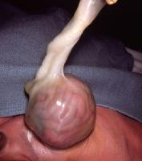
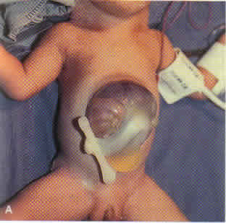
Omphalocele

Slide 39
Gastroschisis
Similar to omphalocele but abdominal wall defect is not at umbilicus & is not covered by peritoneal sac, so contents spill freely
Harder to repair
Incidence about 1 to 3 in 10,000 births
Sterile technique, keep warm, keep hydrated, NG to keep GI system decompressed
Repair is surgical, often done in stages
Pathophysiology
Abnormal involution of right umbilical vein
Rupture of a small omphalocoele
Failure of migration and fusion of the lateral folds of the embryonic disc on the 3rd-4th week of gestation

Slide 40
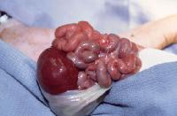
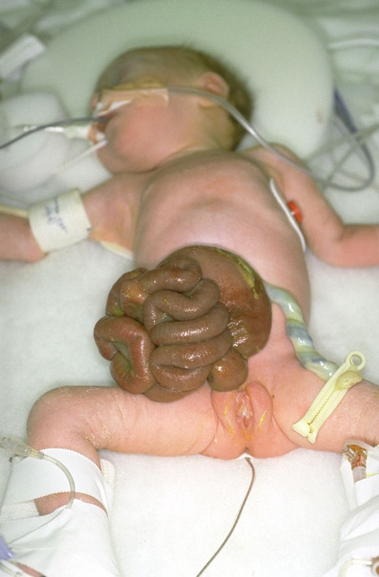
Newborns with large defect will have severe respiratory distress (life-threatening condition)
Lung on affected side is not expanded, and may not have developed properly (hypoplastic lung)

Slide 41
Treatment
Requires NICU care
Surgical correction – may require staged surgery, must have ventilator support
Pre-op: assess VS frequently, elevate HOB and position on affected side (collapsed lung down), maintain NG tube, monitor IV fluids, maintain mechanical ventilation, provide minimal stimulation, support family
Nursing Management
Post-op
Elevate the repair bag, maintain NG and chest tubes, suction prn, maintain IVs and TPN (may need ECMO) Post-op: monitor for infection, continue respiratory support, organize care to decrease stimulation, assess/maintain adequate nutrition, support and educate family

Slide 42
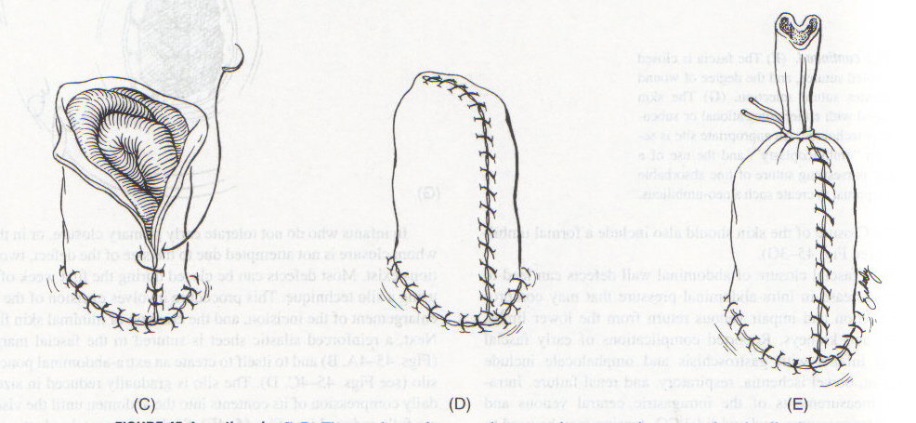
Staged closure of gastroschisis

Slide 43
Obstructive disorders
Pyloric Stenosis
Circumferential muscle of pylorus thickens, resulting in elongation and narrowing of pylorus channel
This produces outlet obstruction, compensatory dilation, hypertrophy and hyperperistalsis of the stomach
Manifestations
Emesis immediately after feeding beginning about 2 to 4 wks of age and grows increasingly forceful until projectile, usually smells sour because digestion had begun
projectile vomiting (not bile-stained), which increases in frequency and severity with time
constant hunger even after vomiting
Visible peristalsis
Metabolic alkalosis
Failure to thrive

Slide 44
Diagnosis
History of projectile vomiting, visible peristaltic waves on abdomen, palpable olive-sized mass in LUQ when stomach is empty
Confirmed by u/s; elongated, sausage-shaped mass with elongated pyloric channel
Decreased K+, Na+, Cl-, increased pH; metabolic alkalosis
Treatment
Small feedings if obstruction is not severe
If severe; correct fluid and electrolyte imbalance
Surgical repair of pyloric sphincter (pyloromyotomy; Fredet-Ramstedt procedure)
Routine post op care with PO volume restricted feedings to allow suture line to heal

Slide 45
Intussusception
Occurs when one segment of the bowel telescopes into lumen of adjacent segment of intestine.
This causes inflammation and edema resulting in blood vessel occlusion leading to necrosis.
It most commonly involves ileum passing into the caecum and colon through the ileocaecal valve
Causes include;
Idiopathic
Lead point: an identifiable change in the intestinal mucosa , malformations include polyps, cysts, tumors, Meckel's diverticulum, and hematomas cystic fibrosis.
Postoperative: May be due to interrupted motility from anesthesia or direct handling of the intestine. It can also occur from placing long tubes into the bowel.
Intussusception is the commonest cause of intestinal obstruction in infants after the neonatal period.
It usually occurs between 2 months and 2 years of age and resuscitation and reduction are urgent.

Slide 46
Clinical presentation
Paroxysmal, severe colicky pain and pallor - during episodes of pain, the child becomes pale, especially around the mouth, and draws up his legs
Sausage-shaped mass - often palpable in the abdomen
Passage of a characteristic redcurrant jelly stool comprising blood-stained mucus
Abdominal distension and shock.
Fecal material in vomit
DX; Barium enema: Shows intussusceptions
Treatment
Insert an NG tube to reduce vomiting and decompress the GI tract.
Hydrostatic reduction of bowel: The bowel is moved back into position using a barium solution, water-soluble contrast solution, or air pressure.
Surgery: Pulling the intussusceptions back into position or resectioning the bowel if other treatments fail to resolve the intussusceptions.

Slide 47
Hirschsprung’s disease
Congenital condition where there is the lack of nerve cells in the colon causing lack of peristalsis, resulting in stool being unable to be pushed through the colon.
Also referred to as congenital aganglionic megacolon.
The aganglionic segment is most frequently located in the rectosigmoid area.
Rectal examination; narrowed segment and withdrawal of the examining finger often releases a gush of liquid stool and flatus due to temporary improvement in the obstruction following the dilatation caused by the rectal examination can lead to a delay in diagnosis.
Clinical manifestation
Failure to pass meconium within the first 48 hours following birth
Abdominal distention
Abdominal mass; easily palpable fecal mass present
Ribbon-like or pellet shaped foul smelling stool
Enterocolitis; inflammation of intestine and colon
DX
Abdominal radiograph: Shows distended colon
Rectal biopsy: Absence of ganglion cells in the colon

Slide 48
Treatment
Colostomy to allow infant defecate and gain weight
Pull through procedure; affected segment resectioned and anastomosed when infant is 6-15 months and closure of colostomy
Nursing intervention
Preoperative care:
• NPO
• Administer IV fluids to prevent maintain fluid and electrolyte balance.
• Insert an NGtube to decompress the upper GI tract.
• Administer enemas to clean the bowel.
• Administer antibiotics
Postoperative care:
• Strict input and output.
• Provide care for the colostomy or ileostomy
• Monitor bowel sounds and start feeding when present.
Explain the disorder and treatment to the family and instruct them on proper care for the wound, care of colostomy or ileostomy, and to seek treatment at first signs of constipation, dehydration, fever, vomiting, and diarrhea.

Slide 49
Malabsorption disorders
Celiac disease
Celiac disease (CD), also called gluten-sensitive enteropathy, is a disease of the small intestines characterized by a permanent inability to tolerate dietary gluten.
Autoimmune disorders common in Children with type I DM and IgA deficiency should be screened for celiac
50x more common in Down syndrome
Chronic malabsorption syndrome due to sensitivity to protein, particularly the gluten protein found in grains (wheat, barley, rye, oats)
Gluten consists of two proteins i.e. gluten and gliadin. The harmful protein is gliadin
When children with celiac disease ingest such protein, changes occur in the intestinal mucosa or villi that prevent absorption of foods across the intestinal villi into the bloodstream; Most noticeable malabsorption developed is inability to absorb fat
Celiac panel screening (antigliadin antibodies, transglutaminase antibodies)

Slide 50
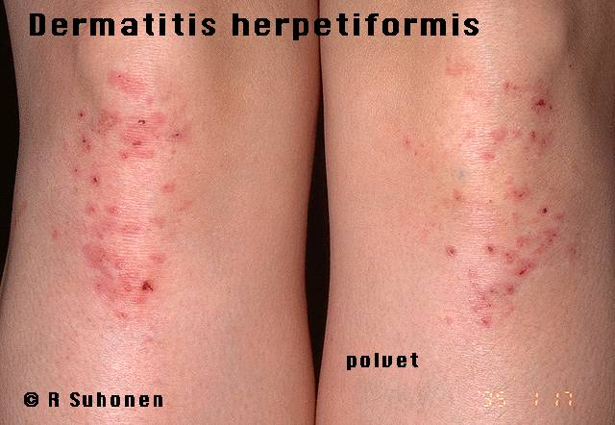
Celiac disease
Relatively rare but early dx is essential for continued health
Dominant inheritance in children of northern European descent; children have varying degrees of involvement (disease can be mild to severe)
Classic presentation – patient <2 years of age with diarrhea, poor weight gain, abdominal distention and proximal muscle wasting
Dermatitis herpetiformis – itchy, bullous lesions on the extensor surfaces of arms, legs, trunk, and scalp

Slide 51
Celiac disease
Diagnosis
Positive small bowel biopsy
Complete remission on gluten free diet
Manifestations
Steatorrhea, vitamin deficiencies of ADEK, malnutrition
Distended abdomen with skinny extremities
Anorexia
Irritability
Growth failure
May develop rickets due to vit D deficiency and clotting disorders due to vit K deficiency
Rx: gluten-free diet for life (priority is pt. education on diet)
Increase dietary protein, calories.
Decrease dietary fat.
Administer water-soluble vitamins A and D.
Administer iron supplements.
Administer folic acid.

Slide 52
Inflammatory disorders
Appendicitis
Inflammation of vermiform appendix
This may be caused by obstruction by fecalith, calculi, tumors, parasites or foreign bodies.
Most common cause of abdominal surgery in children
Seen most frequently in adolescent boys (10 to 30 year-olds)
Typical history: anorexia for 12 to 24 hours, may have nausea and vomiting, gradual development of diffuse abdominal pain or cramps (often periumbilical) with eventual localization at McBurney’s point
Displaced appendix is common, so pain may not be RLQ
Clinical presentation
Pain
Anorexia and vomiting
Fever
Difficult to differentiate from gastroenteritis (symptoms are often identical), but rebound tenderness is specific for appendicitis
WBC elevated
u/s is usually diagnostic
Absent bowel sounds may indicate rupture and peritonitis

Slide 53
Diagnosis
Based on hx and PE
Abdominal tenderness on palpation
Tenseness of muscle (rigidity) over tender area
Guarding; involuntary contraction of abdominal muscles caused by fear of abdominal pain- indicates peritonitis
Rebound tenderness
Signs of peritonitis
Elevated WBC; may be present but not always
u/s is confirmatory
Rx;
Surgical removal of the appendix (appendectomy).
Intravenous fluids until diet resumed.
Pain medications after surgery as needed; pain medication is used cautiously preoperatively to maintain awareness of increase in pain due to possible rupture of appendix.
Antibiotics postoperatively

Slide 54
Inflammatory bowel disease
Refers to a grp of chronic disorders causing inflammation or ulceration in the small and large intestine. This includes:
Ulcerative colitis (UC)
Inflammation of mucosa and sub mucosa of colon and rectum.
Disease presents with rectal bleeding, diarrhoea, colicky pain and weight loss.
Crohn’s disease (CD)
Inflammation of entire GIT, affecting all layers of bowel wall (transmural) but most commonly the distal ileum and proximal colon
The affected intestine is thickened and adhesions between affected loops are common.
Perianal skin tags, fissures and fistulae are also common.

Slide 55
Pathophysiology
Cause is unknown – infectious agents, autoimmune, genetic and environmental factors have been implicated
Triggering factor (virus or atypical bacterium) interacts with body’s immune system inducing inflammatory reaction in the intestinal wall.
Vasoconstriction and release of cellular mediators resulting in edema
The swollen engorged bowel is fragile therefore inclined to ulcerate, causing a break in the mucosal barrier
Digestive enzymes and intestinal bacteria act on the exposed tissue causing further irritation, inflammation, ulceration and bleeding.
Ulcers may become fissures and penetrate deeply into intestinal wall, fistulas to adjacent organs may occur
Inflammatory exudates draws more fluid into the bowel resulting in bloody diarrhea
Healing lesions result in scar tissue formation and scarring of bowel mucosa that may result in stricture formation and bowel obstruction

Slide 56
Clinical manifestation
UC
Rectal bleeding resulting in mild anemia
Diarrhea
colicky pain
Anorexia and weight loss.
Urgency to defecate
Extraintestinal complications include erythema nodosum, pyoderma gangrenosum, arthritis and spondylitis.
CD
Clinical manifestation determined primarily by the location and extent of disease involvement
Abdominal pain
Diarrhoea
Growth failure with pubertal delay
oral and perianal ulcers
Extraintestinal symptoms ; intermittent fever, arthritis, uveitis and erythema nodosum

Slide 57
Treatment
Goals
Control the disease
Induce remission and prevent relapses
provide adequate nutrition
Assist child to function normally
Pharmacotherapy- decrease inflammation and suppress immune system
Corticosteroids
Aminosalicylates- sulfasalazine
Antibiotics
Immunosuppressant-cyclosporine
Nutritional support
Avoid dairy products, highly seasoned foods and high fiber diet
High calorie diet
Vitamin supplement
Surgery
Severe complications of IBD

Slide 58
Peptic ulcers
Occur as a result of erosion of mucosal wall of GIT
An ulcer is distinguished from an erosion by its penetration through the muscularis mucosa or the muscular coating of the gastric or duodenal wall.
Classified according to mechanism of occurrence and anatomical location
Primary; in absence of underlying disease
Secondary (stress); associated with physiological stress of underlying systemic disease, drugs.
OR
Gastric; located at junction of fundus and pylorus on lesser curvature of stomach
Duodenal; in pylorus or duodenum
Primary ulcers most common in older children and adolescents
Below 6 years, most ulcers are secondary
Close association between H. Pylori with occurrence of duodenal ulcers

Slide 59
Pathophysiology
PUD results from the imbalance between defensive factors that protect the mucosa and offensive factors that disrupt this important barrier.
Some mucosal protective factors include the water-insoluble mucous gel layer, local production of bicarbonate, regulation of gastric acid secretion, and adequate mucosal blood flow.
Aggressive factors include the acid-pepsin environment, infection with Helicobacter pylori, and mucosal ischemia.
Clinical manifestation
Abdominal pain
The pain is usually dull and vague.
The pain may be poorly localized or localized to the periumbilical or epigastric areas.
Frequent exacerbations and remissions of pain extend over weeks to months
Anorexia,vomiting
Hematemesis
Occult bleeding
Anemia

Slide 60
Treatment
Goals
Relieve pain
Hasten healing
Prevent complications
Pharmacotherapy
Neutralization of gastric acid- antacids
Reduction of gastric acid secretions- H2 receptor blockers
Suppression of gastric acid secretion- PPI’s
Treatment of H. pylori- antibiotics and bismuth preparations
Surgery if complications occur

Slide 61
Hepatitis
Acute or chronic inflammation of the liver
Causes
Viral- most common
Bacterial
Fungal
Parasitic infections
Chemical and drug toxicity
After exposure to hepatitis virus, liver becomes inflamed, causing damage to hepatocytes
Edema of liver causes obstruction of bile ducts causing biliary stasis and further destruction of the cells.
Most cases self limiting with regeneration of hepatocytes. Hep B and C however cause chronic condition characterized by progressive liver failure, cirrhosis and liver cancer

Slide 62
Hepatitis A
RNA virus, transmitted fecal-orally (food and water)
Incubation is 15-50 days
Acute infection – high anti-HAV IgM
Previous infection – high anti-HAV IgG
Symptoms rare in children
1% have chance of fulminant hepatitis
Hepatitis B
DNA virus, transmitted by contaminated serum contact, incubation 1-6 months
Anti-Hb IgM confirms diagnosis during this period
Risk factor; multiple blood transfussion, perinatal transfussion, sexual transmission, IV drug use
Clinical presentation
Prodromal symptoms (fever, arthritis, urticaria, and angioedema)
Jaundice and patient feels better, and cholestatic symptoms

Slide 63
Developing chronic HBV is inversely proportional to age (90% of infected infants develop chronic hepatitis, 5% of older children/adults)
1% develop fulminant hepatitis, 5-7% develop chronic carrier states
Carrier states
Asymptomatic
Chronic persistent hepatitis
Chronic hepatitis B – cirrhosis and hepatocellular cancer
Hepatitis C
Single-stranded RNA virus, blood born transmission
Most common cause of liver disease
Extrahepatic disease
Small vessel vasculitis with glomerulonephritis neuropathy
Mixed cryoglobulinemia – palpable purpura

Slide 64
Other Hepatitis
Hepatitis D
RNA virus, requires hepatitis B infection to be pathogenic
Hepatitis E
RNA virus, spreads fecal-orally
Very high risk for fulminant hepatitis in the 3rd trimester of pregnancy – 20% fatality rate
Acute hepatitis, negative serology, and a traveler = Hepatitis E
Autoimmune Hepatitis
Broad variety of distinct diseases that affect liver
Present with malaise, weight loss, or anorexia to cirrhosis and portal hypertension
family history of other autoimmune diseases
Diagnosis – serum Ab markers, elevated aminotransferases, with elevated protein (hypergammaglobulinemia)
Treat with immunosuppresion

Slide 65
Clinical manifestation
Acute hepatitis:
• Malaise
• Nausea and vomiting
• Diarrhea or constipation
• Low-grade fever
• Dark urine due to change in liver function
• Jaundice due to liver compromise
• Tenderness in right upper quadrant of abdomen
• Hepatomegaly
• Arthritis, glomerulonephritis, polyarteritis nodosa in hepatitis B
Chronic hepatitis:
• Elevated liver enzymes
•Cirrhosis due to altered liver function
• Ascites due to decrease in liver function, increased portal hypertension
• Bleeding from esophageal varices
• Encephalopathy due to diminished liver function
• Bleeding due to clotting disorders
• Enlargement of spleen

Slide 66
Treatment
Mainly supportive/ symptomatic
Vaccination:
Hep A vaccine is given to children within 2 weeks of exposure
Hep B vaccine administered to children as routine part of immunization schedule

Slide 67
Biliary Atresia
Characterized by congenital absence or obstruction of extrahepatic bile ducts.
May also be as a result of progressive inflammatory process that causes bile duct fibrosis.
Cause is unknown; prenatal- viruses, toxins, or chemicals are suspected or viral infection in neonates.
Obstruction of bile ducts doesn’t allow flow of bile out of liver and into small intestine and gall bladder; bile plugs form and cause bile accumulation in liver; inflammation, edema and irreversible hepatic injury occur; liver becomes fibrotic, leading to cirrhosis and portal hypertension.
Without bile in the intestines, fat and fat-soluble vitamins cannot be absorbed, leading to malnutrition and growth failure.

Slide 68
Clinical manifestation
Appears healthy at birth, jaundice occurs within 2 wks to 2 months.
Signs of hepatic failure (clay stools, brown urine, itching, abdominal distention).
Tea colored urine due to excretion of bilirubin and bile salts.
FTT and malnutrition eventually develop
Biliary atresia is fatal without treatment
Temporary treatment – supportive care and surgery to temporarily correct obstruction
Only permanent treatment is liver transplant

